Slide 1
Railway Oriented Programming A functional approach to error handling
Scott Wlaschin
@ScottWlaschin
fsharpforfunandprofit.com
FPbridge.co.uk
Examples will be in F#...
...but OCaml and Haskell are very similar.
Notes:
This talk is targeted as beginners – how many of you know and use the Either monad?
So, if you are an expert, apologies in advance for telling you things you already know, but perhaps the metaphors I use might be helpful when explaining this stuff to other people?

Slide 2
Overview
Topics covered:
Happy path programming
Straying from the happy path
Introducing "Railway Oriented Programming"
Using the model in practice
Extending and improving the design
Notes:
Domain-driven design applied to errors
Processing events in parallel
Domain Events

Slide 3

Happy path programming
Implementing a simple use case

Slide 4
A simple use case
"As a user I want to update my name and email address"
Receive request
type Request = { userId: int; name: string; email: string }
Validate and canonicalize request
Update existing user record
Send verification email
Return result to user
Notes:
Let's pick a very simple use case, namely updating some customer information via a web service.
So here are the basic requirements:
* A user submits some data (userid, name and email).
* We check to see that the name and email are valid.
* The appropriate user record in a database is updated with the new name and email.
* If the email has changed, send a verification email to that address.
* Display the result of the operation to the user.
This is a typical *data centric* use case. There is some sort of request that triggers the use case, and then the request data "flows" through the system, being processed by each step in turn.
This kind of scenario is common in enterprise software, which is why I am using it as an example.
This recipe is also deliberately somewhat imperative, that is, it uses an explicit step-by-step workflow. I hope this approach will ease the transition from OO to FP.
I’m not using a reactive model, or CQRS or event sourcing – this is classic old school approach.

Slide 5
Imperative code
string ExecuteUseCase()
{
var request = receiveRequest();
validateRequest(request);
canonicalizeEmail(request);
db.updateDbFromRequest(request);
smtpServer.sendEmail(request.Email);
return "Success";
}
Notes:
So how would we implement this in a standard imperative code.

Slide 6
Functional flow
let executeUseCase =
receiveRequest
>> validateRequest
>> canonicalizeEmail
>> updateDbFromRequest
>> sendEmail
>> returnMessage
F# left-to-right composition operator
Notes:
Functional code is similar – data flows through the functions one by one
I'm using the F# left to right composition operator here. Haskell people, replace with a dot and reverse the order (or use triple from Control.Arrow). In Ocaml, I don't know what you'd use...

Slide 7
Functional flow (Haskell version)
let executeUseCase =
receiveRequest
∙ validateRequest
∙ canonicalizeEmail
∙ updateDbFromRequest
∙ sendEmail
∙ returnMessage
receiveRequest
>> validateRequest
>> canonicalizeEmail
>> updateDbFromRequest
>> sendEmail
>> returnMessage
Haskell version!
Notes:
>> means something different in Haskell, so let me show you how to do this in Haskell
If you use Haskell, remember that everything is backwards, so you have to write your functions like this:
Only joking – Seriously, Haskell people can use the left-to-right composition operator (triple greater than) from Control.Arrow

Slide 8
Functional flow
executeUseCase =
returnMessage
. sendEmail
. updateDbFromRequest
. validateRequest
. receiveRequest
Notes:
Functional code is similar – data flows through the functions one by one
I'm using the F# left to right composition operator here. Haskell people, replace with a dot. In Ocaml, I don't know what you'd use...

Slide 9
Functional flow
import Control.Arrow
executeUseCase =
receiveRequest
>>> validateRequest
>>> updateDbFromRequest
>>> sendEmail
>>> returnMessage
Notes:
Seriously, Haskell people can use the triple arrow from Control.Arrow

Slide 10
Straying from the happy path...
What do you do when something goes wrong?
Notes:
Error handling is what separates serious code from weekend hacks. Anyone who has worked on complex enterprise software knows that a good chunk of your code is not the business logic itself, but all the error handling that goes with it

Slide 11

Straying from the happy path
Notes:
One thing is that many examples of using functional programming are just like the code samples I just showed you.
A bit over simplified and gives the impression that functional programmers are naive and don't think about the real world.

Slide 12
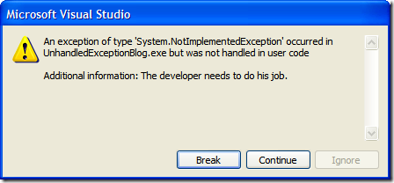
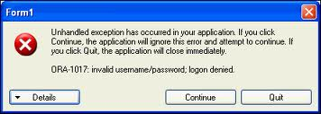
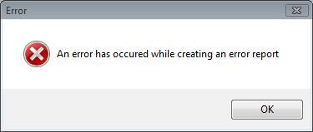
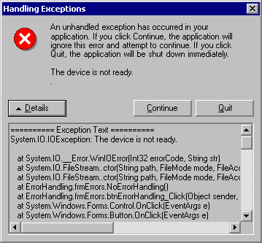
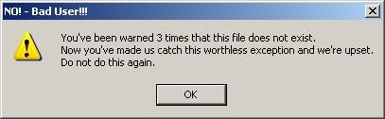
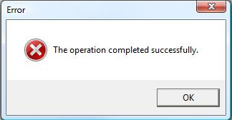
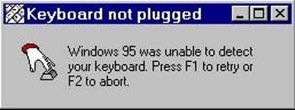
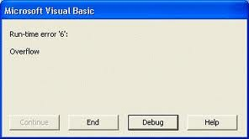
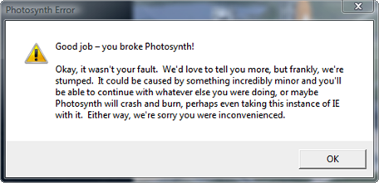
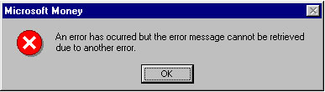
“A program is a spell cast over a computer, turning input into error messages”
Notes:
Proper error handling is what separates serious code from weekend hacks. Anyone who has worked on complex enterprise software knows that a good chunk of your code is not the business logic itself, but all the error handling that goes with it

Slide 13

Straying from the happy path
"As a user I want to update my name and email address"
- and see sensible error messages when something goes wrong!
Receive request
type Request = { userId: int; name: string; email: string }
Validate and canonicalize request
Name is blank Email not valid
Update existing user record
User not found Db error
Send verification email
Authorization error Timeout
Return result to user
Notes:
So lets look at error handling in our use case.
Here are just a few of the things that could go wrong.
Validation: the email might not be valid, the name might be too long, the customer id might be null,

Slide 14
Imperative code with error cases
string ExecuteUseCase()
{
var request = receiveRequest();
var isValidated = validateRequest(request);
if (!isValidated) {
return "Request is not valid"
}
canonicalizeEmail(request);
try {
var result = db.updateDbFromRequest(request);
if (!result) {
return "Customer record not found"
}
} catch {
return "DB error: Customer record not updated"
}
if (!smtpServer.sendEmail(request.Email)) {
log.Error "Customer email not sent"
}
return "OK";
}
Q: What is the functional equivalent of this code?
... and can we preserve the elegance of the original functional version?
6 clean lines -> 18 ugly lines. 200% extra! Sadly this is typical of error handling code.
Notes:
All the new error handling code is in red.
I’ve gone from 6 lines of clean code to 18 lines of ugly code. Typical 2x of code focused on non-core flow vs 1x of "useful" code
These are crude errors too – I'd actually want to handle special exceptions as well. And what about translating the text into languages other than english, etc.
What happens if SendMail fails – should I return a error to the user: no. But logging the error is not enough either. I want to capture the error and try sending it again later. That makes my code even more complicated.
What is the functional equivalent of this code?

Slide 15
Request/response (non-functional) design
Request handling service
Request
Validate
Update
Send
Response
Request handling service
Happy path – without errors
Request
Validate
Update
Send
Response
Request handling service
Request
Validate
Update
Send
Unhappy path – with errors
Errors
Response
Imperative code can return early
Notes:
In the use case, we typically think of a request/response model. The request is sent, and the response comes back. If something goes wrong, the flow is short-circuited and response is returned "early".
Here's a diagram showing what I mean, based on a simplified version of the use case:

Slide 16
Data flow (functional) design
Request
A single function representing the use case
Validate
Update
Send
Response
A single function representing the use case
Request
Validate
Update
Send
Response
Happy path – without errors
A single function representing the use case
Request
Validate
Update
Send
Success Response
Errors
Error Response
Q: How can a function have more than one output?
Q: How can you bypass downstream functions when an error happens?
Notes:
But in the functional model, a function is a black box with an input and an output, like this:
Behind the scenes, the overall function is created by composing smaller functions together.
functional data flow is *forward only*. You cannot do a U-turn or return early.
In our case, that means that all the errors *must* be sent forward to the end, as an alternative path to the happy path.
Q: How can you bypass downstream functions when an error happens?
there is one success output and three error outputs. This is a problem, as functions can have only *one* output, not four!
Q: How can a function have more than one output?
How can we adapt the use case to fit this model?

Slide 17
Functional design
How can a function have more than one output?
type Result =
| Success
| ValidationError
| UpdateError
| SmtpError
I love sum types!
But maybe too specific for this case?
Notes:
This does solve the problem, but having one error case for each step in the flow is brittle and not very reusable. Can we do better?

Slide 18
Functional design
How can a function have more than one output?
type Result =
| Success
| Failure
Much more generic – but no data!
Notes:
Much nicer
One more thing though -- as it stands there is no data in the result at all, just a success/failure status. We need to tweak it a bit so that it can contain an actual success or failure object. We will specify the success type and failure type using generics (a.k.a. type parameters).

Slide 19
Functional design
How can a function have more than one output?
type Result<'TEntity> =
| Success of 'TEntity
| Failure of string
Good for now – we'll revisit this design later.
Notes:
For now, I just store a message string in the failure case -- I'll revisit this design later.
Note that most functional languages already have a built in type like this – in F# it's called Choice and in Haskell it's called Either, but I'm going to define it explicitly, just to make it obvious.

Slide 20
Functional design
A single function representing the use case
Request
Validate
Update
Send
Success
Errors
Failure
Each use case will be equivalent to a single function
The function will return a sum type with two cases: "Success" and "Failure".
The use case function will be built from a series of smaller functions, each representing one step in a data flow.
The errors from each step will be combined into a single "failure" path.
But we haven't answered the question: How can you bypass downstream functions when an error happens?
Notes:
So here's what the use case looks like now.
Each use case will be equivalent to a single function
The use case function will return a union type with two cases: `Success` and `Failure`.
The use case function will be built from a series of smaller functions, each representing one step in a data flow.
The errors from each step will be combined into a single error path.

Slide 21
How do I work with errors in a functional way?
Notes:
Q: How can you bypass downstream functions when an error happens?

Slide 22
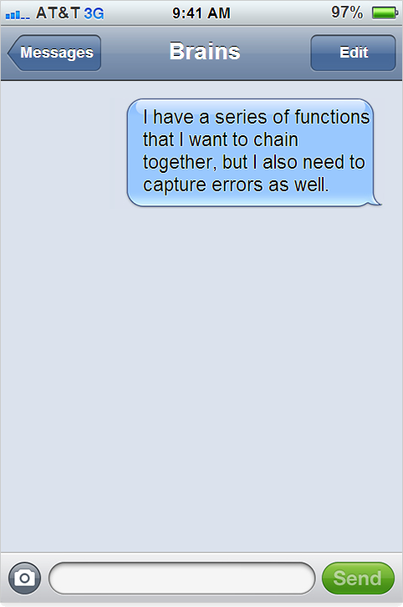


Monad dialog
Very clever
A bear of very little brain

Slide 23
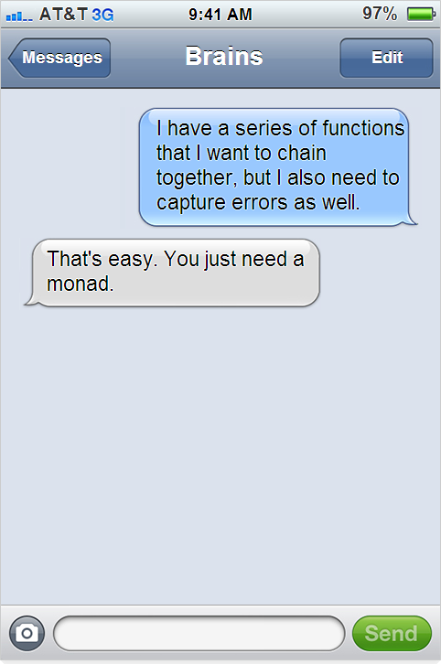

Slide 24
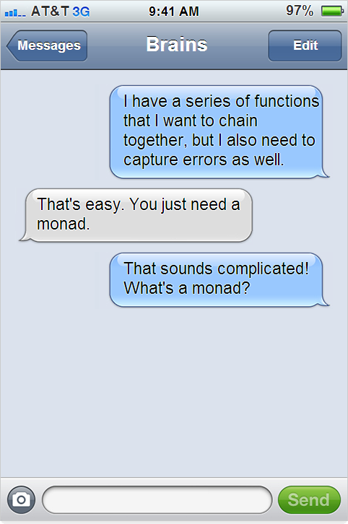

Slide 25
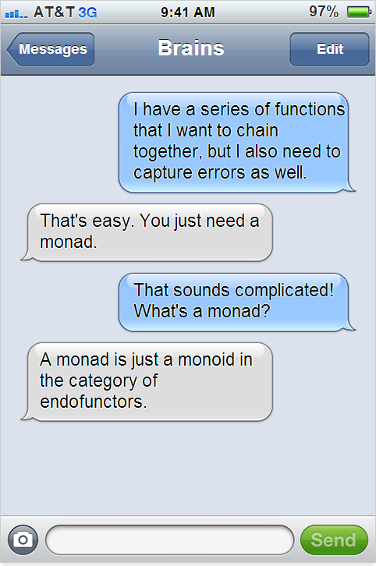

Slide 26
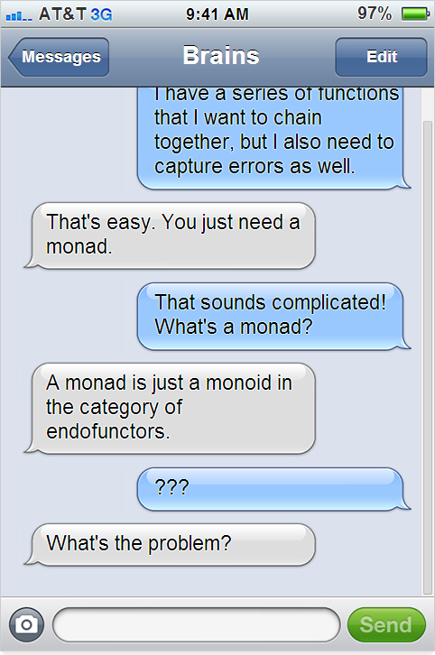

Slide 27
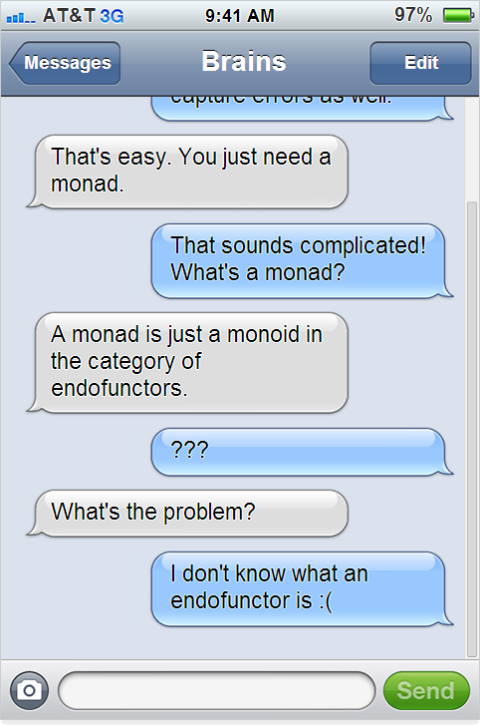

Slide 28
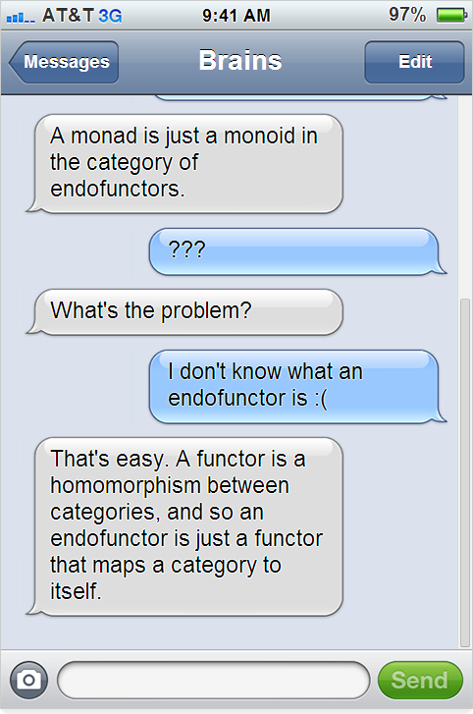

Slide 29
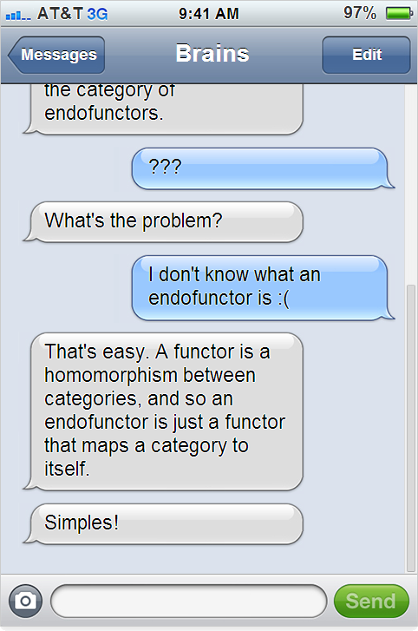

Slide 30
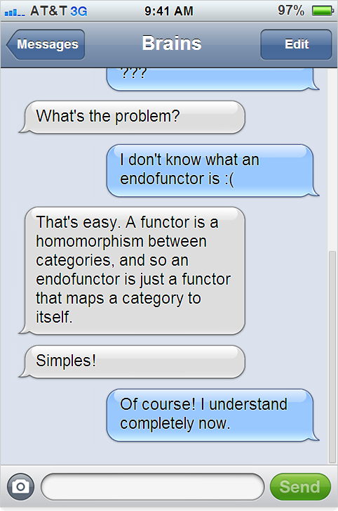

Slide 31
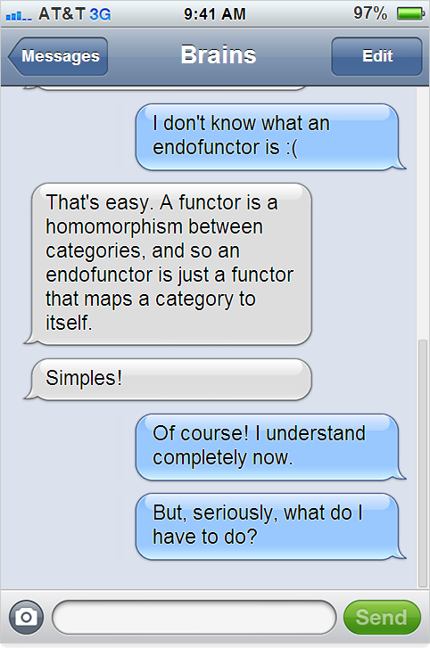

Slide 32
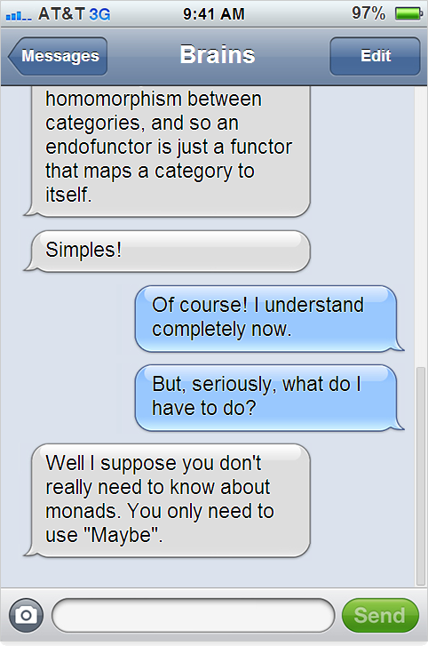

Slide 33
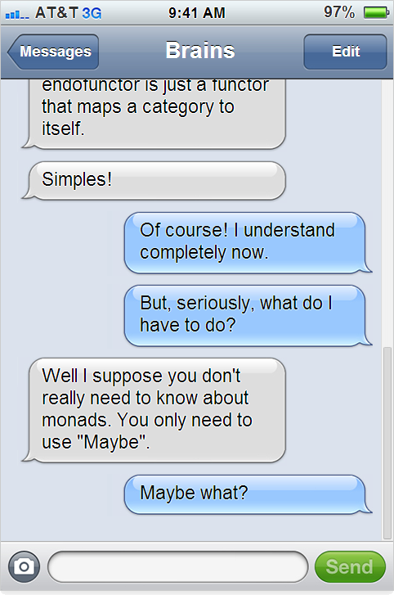

Slide 34
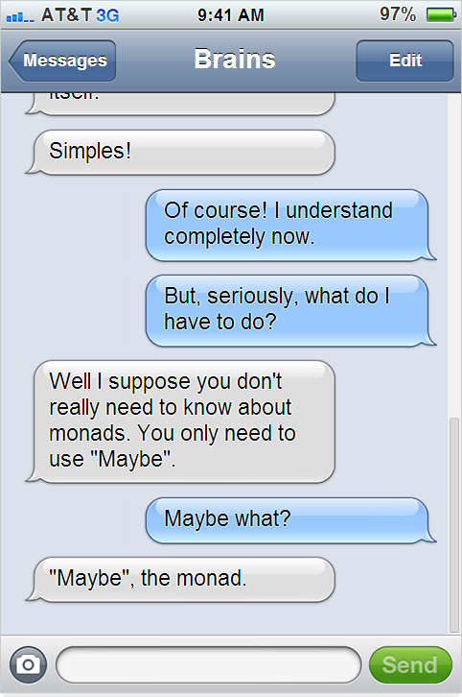

Slide 35
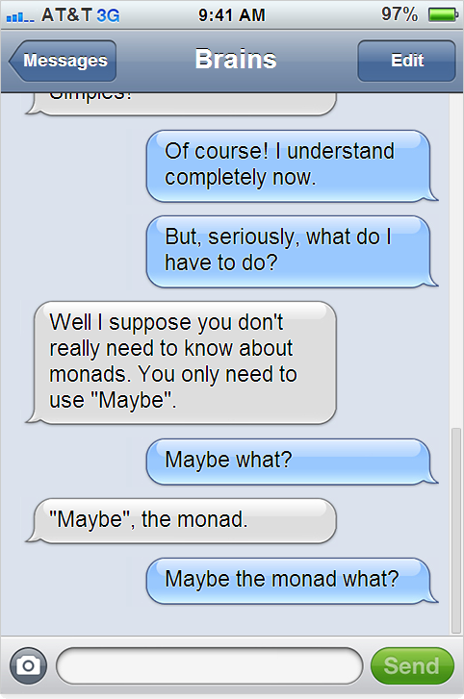

Slide 36
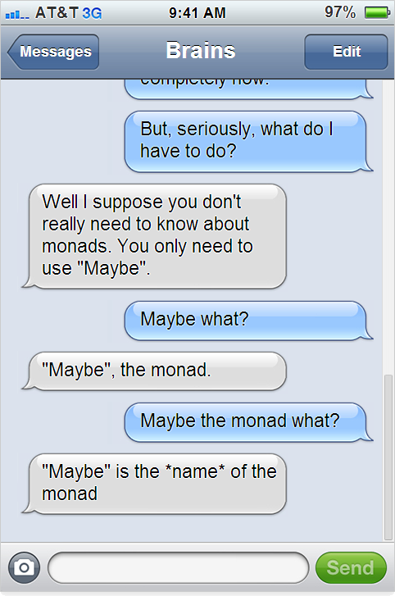

Slide 37
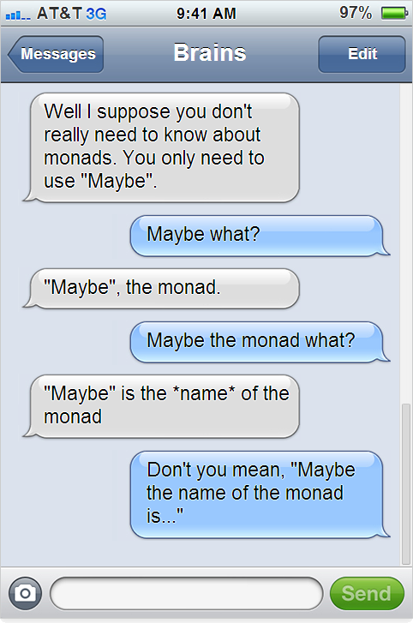

Slide 38
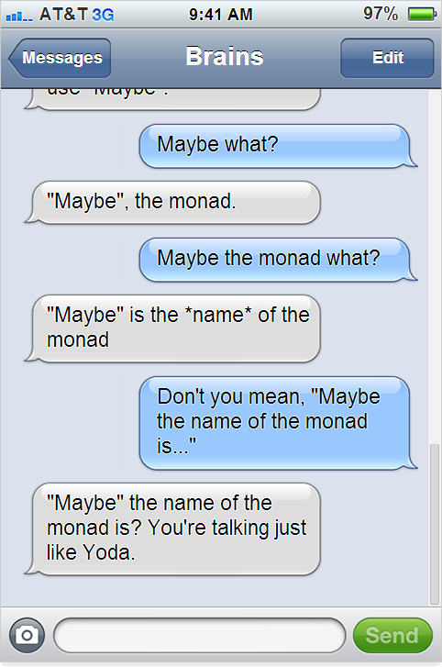

Slide 39
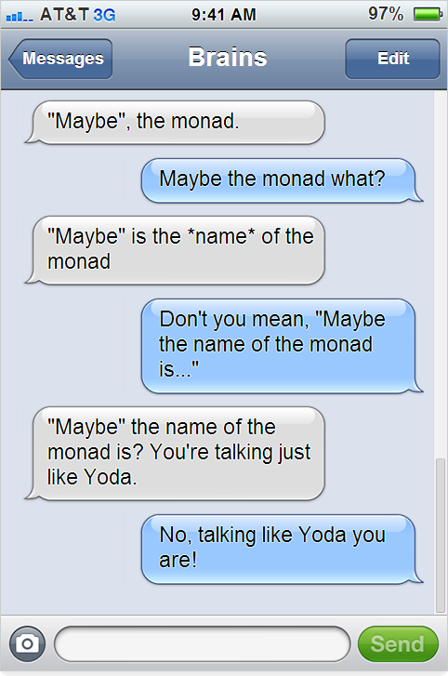

Slide 40
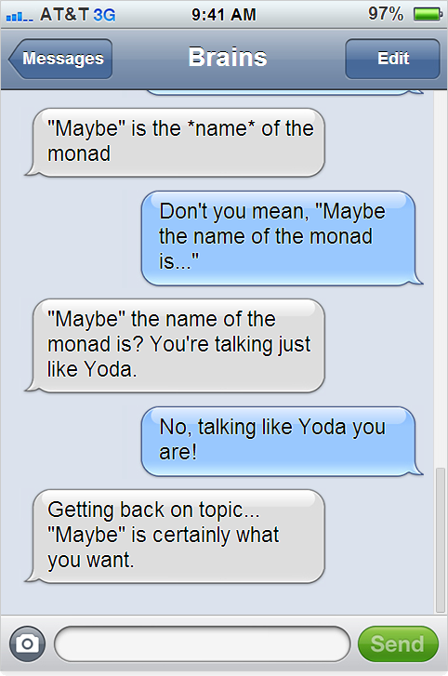

Slide 41
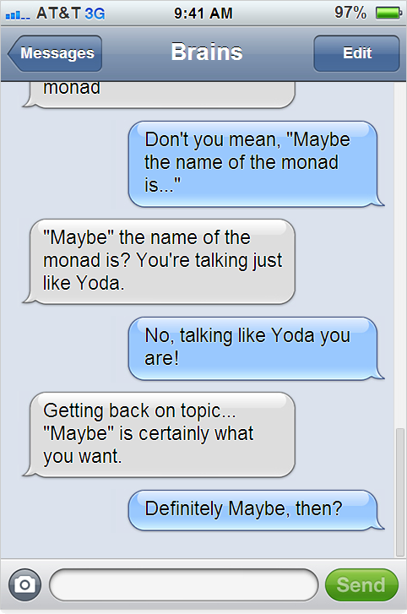
v

Slide 42
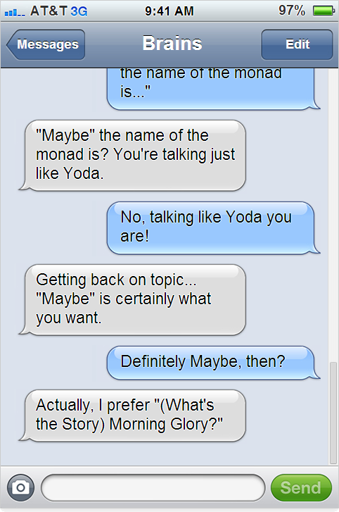

Slide 43
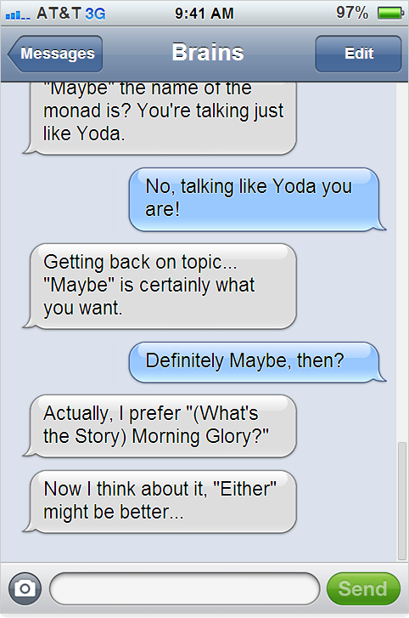

Slide 44
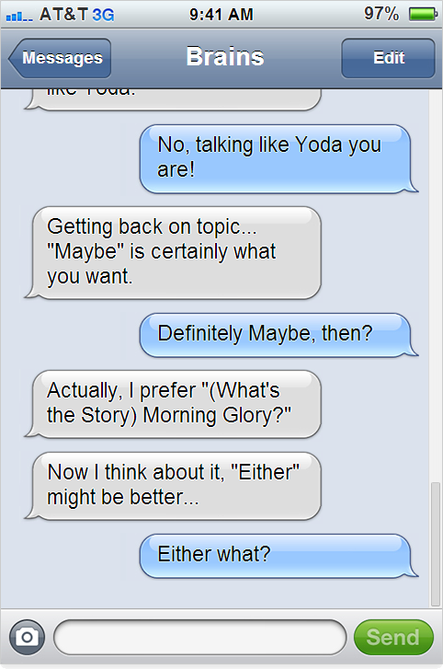

Slide 45
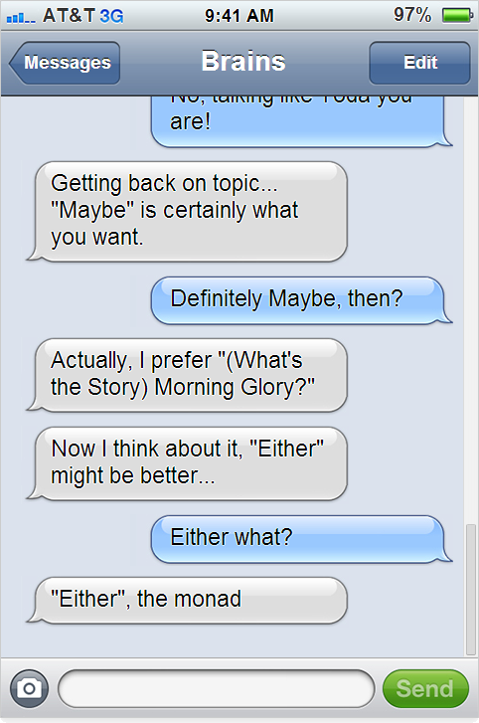

Slide 46
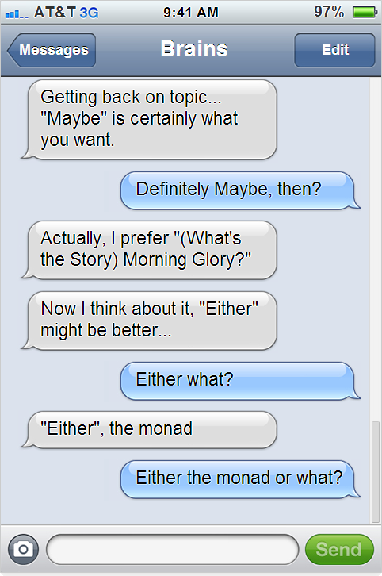

Slide 47
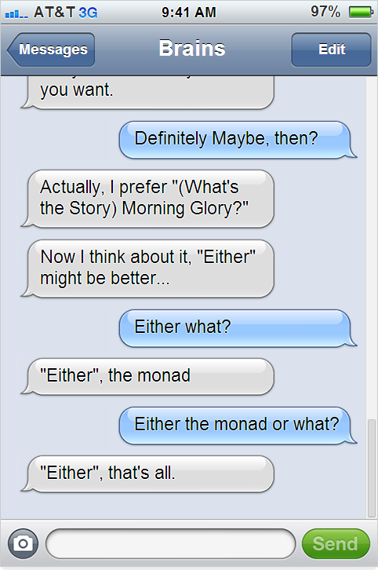

Slide 48
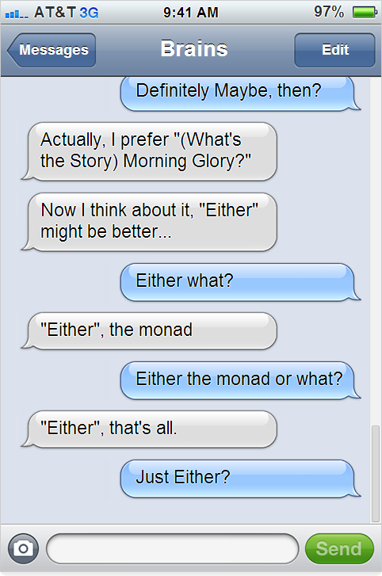

Slide 49
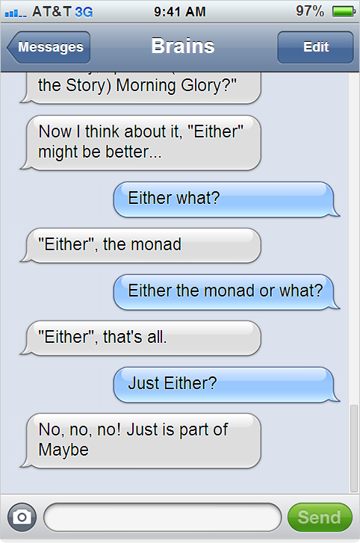

Slide 50
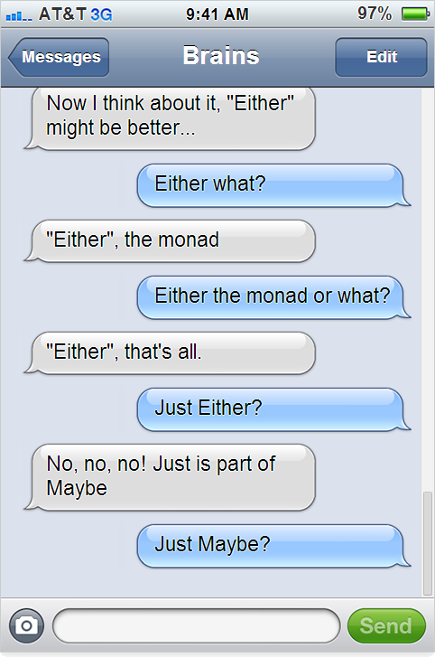

Slide 51
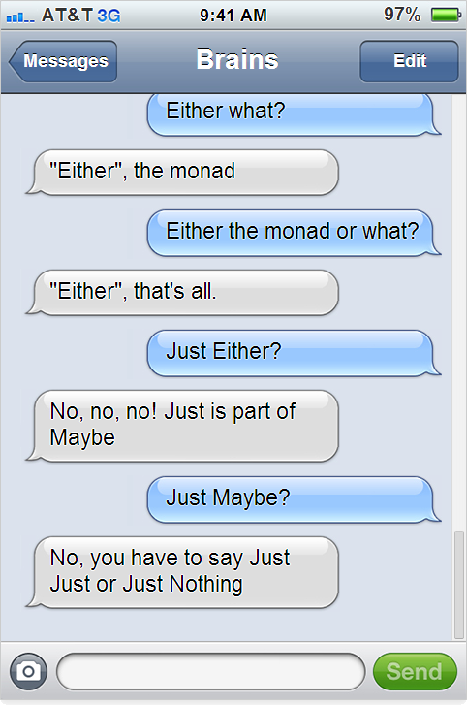

Slide 52
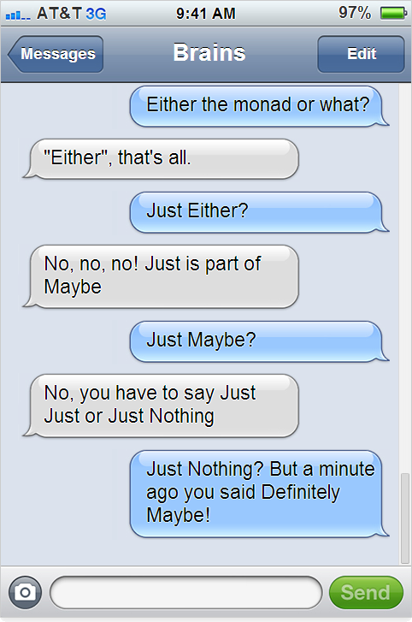

Slide 53
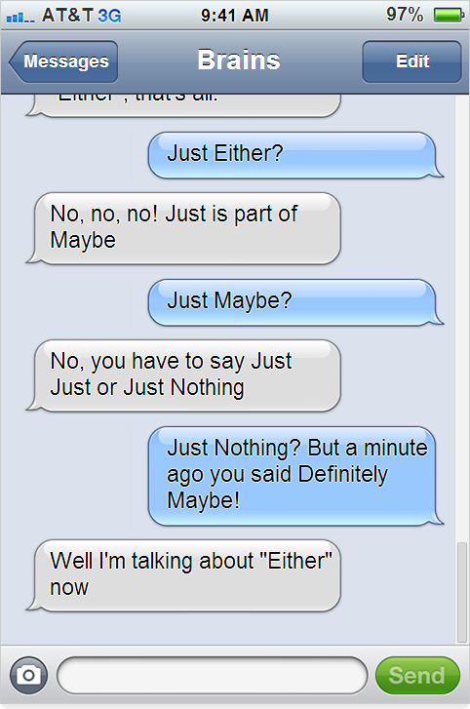

Slide 54
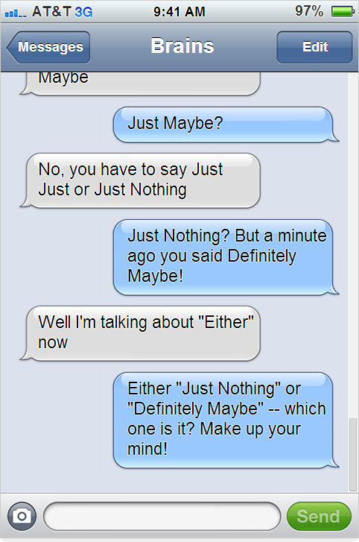

Slide 55
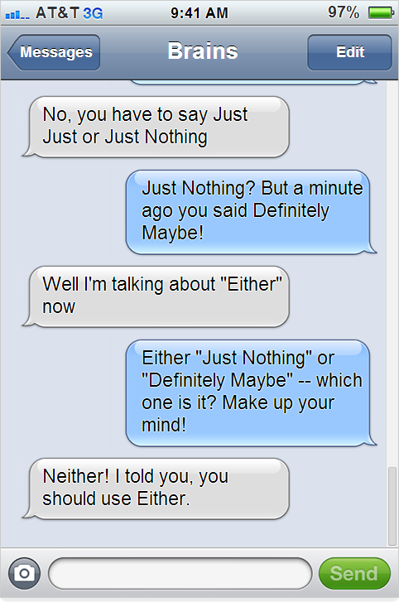

Slide 56
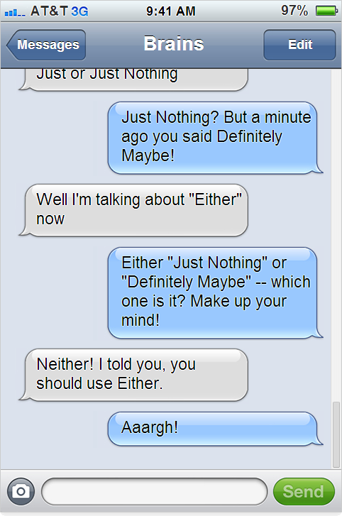

Slide 57
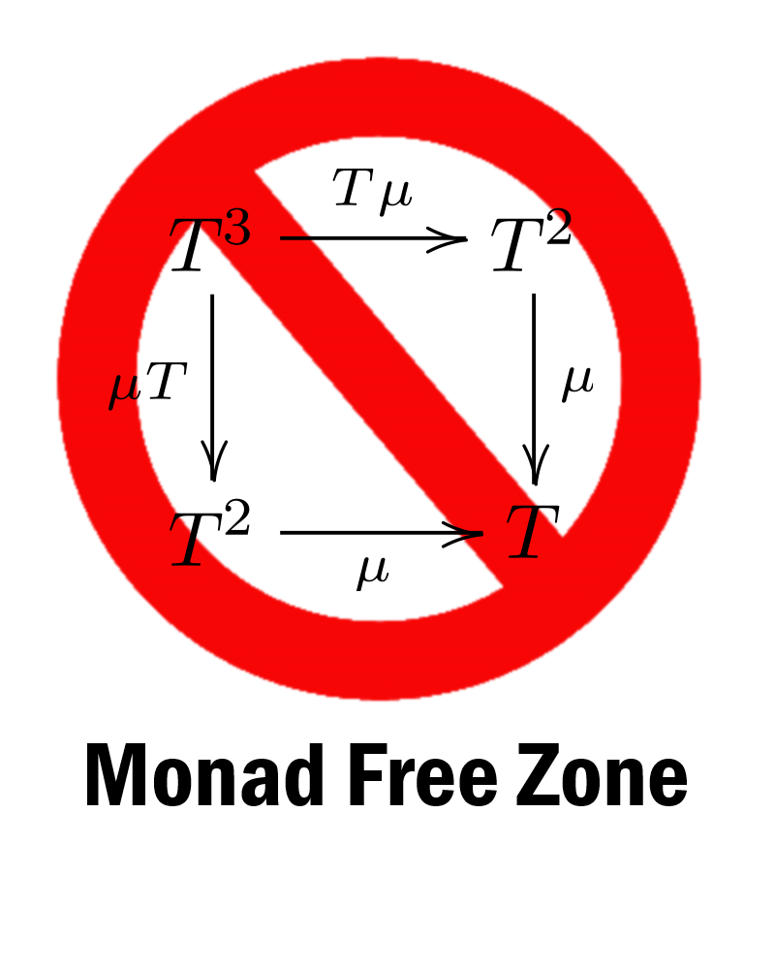
Monads are confusing
Notes:
Monads are confusing – there are blog posts called “I hate monads” and the haskell wiki has a long list of monad tutorials.
So I will choose to avoid all the confusion, and ban monads altogether! The rest of the talk will be a monad free zone.
Doesn’t mean I won’t be using the same concepts – I just won’t call them monads!
Some people might say that this is anti-intellectual, and that you should just learn the standard terminology
I would say no... Understand the concepts first, terminology comes after. In some cases you don’t need to know the terminology at all, like the man who discovered to his astonishment that he had "been speaking prose all his life, and didn't even know it!"

Slide 58
Railway oriented programming
This has absolutely nothing to do with monads.
Notes:
So instead of monads, I’m going to use an analogy that is more concrete and understandable. Railways.

Slide 59

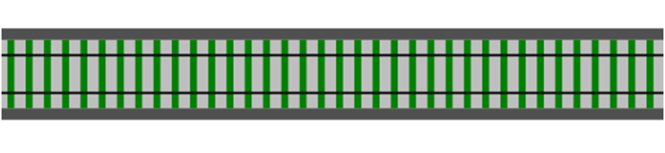

A railway track analogy
The Tunnel of Transformation
Function pineapple -> apple
Notes:
So instead of monads, I’m going to use a analogy that is more concrete and understandable. Railways.
I’m going to represent a function by a piece of railway track.
On the track is a magical tunnel that transforms the cargo of whatever train goes through it.
So ege

Slide 60
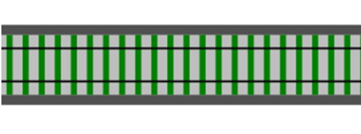

A railway track analogy
Function 1 pineapple -> apple
Function 2 apple -> banana

Slide 61
A railway track analogy
Function 1 pineapple -> apple
>>
Function 2 apple -> banana
Composition
Notes:
I'm using the F# left to right composition operator here. Haskell people, replace with a dot. In Ocaml, I don't know what you'd use...

Slide 62
A railway track analogy
New function
New Function 3 pineapple -> banana
Can't tell it was built from smaller functions!
Notes:
So now we have a brand new function – what's more you can't tell that it was originally built from smaller functions.

Slide 63
An error generating function
Request
Validate
Success
Failure
How do we model this as railway track?
let validateInput input =
if input.name = "" then
Failure "Name must not be blank"
else if input.email = "" then
Failure "Email must not be blank"
else
Success input // happy path
Notes:
Here we have a function that could be a success or failure
Consider the validation function. How would it work? Some data goes in, but what comes out?
Well, there are two possible cases: either the data is valid (the happy path), or something is wrong, in which case we go onto the failure path and bypass the rest of the steps, like this:
So how do we map this to a the railway metaphor?

Slide 64
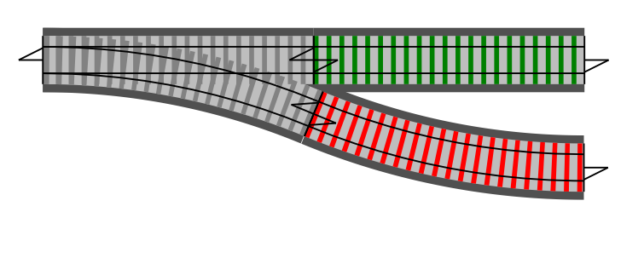
Introducing switches
Input ->
Success!
Failure
Notes:
So how does the railway metaphor help us with error handling?
Railways have switches ("points" in the UK) for directing trains onto a different track. We can think of these "Success/Failure" functions as railway switches, like this:

Slide 65
Connecting switches
Validate
on success
UpdateDb
bypass
Notes:
So we have a lot of these "one input -> Success/Failure output" functions -- how do we connect them together?
What we want to do is connect the `Success` output of one to the input of the next, but somehow bypass the second function in case of a `Failure` output. This diagram gives the general idea:
Do not pass go, do not collect 200 pounds or dollars

Slide 66
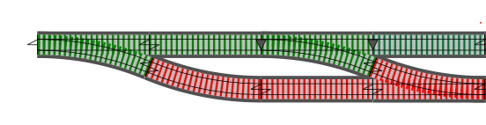
Connecting switches
Validate
UpdateDb
Notes:
So we have a lot of these "one input -> Success/Failure output" functions -- how do we connect them together?
How do we combine them so that both failure tracks are connected? It's obvious -- like this!

Slide 67
Connecting switches
Validate
UpdateDb
SendEmail
Notes:
And if we have a whole series of switches, we will end up with a two track system, looking something like this, how would we combine them?
I'm going to ignore the canonicalize function for now.

Slide 68

Connecting switches
Validate
UpdateDb
SendEmail
This is the "two track" model – the basis for the "Railway Oriented Programming" approach to error handling.
Notes:
So we have a lot of these "one input -> Success/Failure output" functions -- how do we connect them together?
How do we combine them so that both failure tracks are connected? It's obvious -- like this!
And if we have a whole series of switches, we will end up with a two track system, looking something like this:

Slide 69
The two-track model in practice

Slide 70
Composing switches
Validate
UpdateDb
SendEmail
Here we have a series of black box functions that are straddling a two-track railway.
Notes:
Now stepping back and looking at the big picture, we can see that we will have a series of black box functions that appear to be straddling a two-track railway, each function processing data and passing it down the track to the next function:

Slide 71
Composing switches
Validate
UpdateDb
SendEmail
Here we have a series of black box functions that are straddling a two-track railway.
Inside each box there is a switch function.
Notes:
But if we look inside the functions, we can see that there is actually a switch inside each one, for shunting bad data onto the failure track:
Note that once we get on the failure path, we never (normally) get back onto the happy path. We just bypass the rest of the functions until we reach the end.

Slide 72

Composing switches
Validate
UpdateDb
SendEmail
>>
>>
Composing one-track functions is fine...
Notes:
Imagine that a standard function is a black box (a tunnel, say) sitting on a one-track railway. It has one input and one output.
If we want to connect a series of these one-track functions, we can use the left-to-right composition operator, with the symbol `>>`.

Slide 73

Composing switches
Validate
UpdateDb
SendEmail
>>
>>
... and composing two-track functions is fine...
Notes:
The only constraint on composition is that the output type of the left-hand function has to match the input type of the right-hand function.
In our railway analogy, this means that you can connect one-track output to one-track input, or two-track output to two-track input, but you *can't* directly connect two-track output to one-track input.

Slide 74
Composing switches
Validate
UpdateDb
SendEmail
✗
✗
... but composing switches is not allowed!
Notes:
but you *can't* directly connect two-track output to one-track input.

Slide 75

Composing switches
✗
One-track input
Validate
Two-track input
Before: Not suitable for composition
✓
Validate
Two-track input
Two-track input
So how can we convert from the "before" case to the "after" case?
After: Suitable for composition
Notes:
So now we have run into a problem.
The function for each step is going to be a switch, with *one* input track. But the overall flow requires a *two-track* system, with each function straddling *both* tracks, meaning that each function must have a two-track input (the `Result` output by the previous function), not just a simple one-track input (`Request`).
Once we have converted it from a switch to a two-track, then composition is easy.
Now this is not the only way to do composition of railway switches – there's another one I like called "Kleisli composition" – but this is a good one for basic reusable recipe

Slide 76

Bind as an adapter block
Two-track input
Two-track output
Slot for switch function
Notes:
So now we have run into a problem.
The function for each step is going to be a switch, with *one* input track. But the overall flow requires a *two-track* system, with each function straddling *both* tracks, meaning that each function must have a two-track input (the `Result` output by the previous function), not just a simple one-track input (`Request`).
How can we insert the switches into the two track system?
The answer is simple. We can create an "adapter" function that has a "hole" or "slot" for a switch function and converts it into a proper two-track function. Here's an illustration:

Slide 77
Bind as an adapter block
Two-track input
Two-track output
Validate
Validate
Notes:
So now we have run into a problem.
The function for each step is going to be a switch, with *one* input track. But the overall flow requires a *two-track* system, with each function straddling *both* tracks, meaning that each function must have a two-track input (the `Result` output by the previous function), not just a simple one-track input (`Request`).
How can we insert the switches into the two track system?
The answer is simple. We can create an "adapter" function that has a "hole" or "slot" for a switch function and converts it into a proper two-track function. Here's an illustration:

Slide 78
Bind as an adapter block
Two-track input
Two-track output
let bind switchFunction =
fun twoTrackInput ->
match twoTrackInput with
| Success s -> switchFunction s
| Failure f -> Failure f
bind : ('a -> Result<'b>) -> Result<'a> -> Result<'b>
Switch function
2-track input
2-track output
Notes:
And here's what the actual code looks like. I'm going to name the adapter function `bind`, which is the standard name for it.
The bind function takes a switch function as a parameter and returns a new function. The new function takes a two-track input (which is of type `Result`) and then checks each case. If the input is a `Success` it calls the `switchFunction` with the value. But if the input is a `Failure`, then the switch function is bypassed.
One way of interpreting this signature is that the `bind` function has one parameter, a switch function (`'a -> Result<..>`) and it returns a fully two-track function (`Result<..> -> Result<..>`) as output.
Note that this function is completely generic -- it will work with *any* switch function and *any* types. All it cares about is the "shape" of the `switchFunction`, not the actual types involved.
Let's loot at the signature for the function – this is a classic bind signature (sometimes the first two parameters are reversed). Option/Maybe bind, List bind/collect/selectMany will all look the same
In the world of lists, you will see functions with names like collect or selectMany – these are also bind under another name – you can check the sig to be sure.

Slide 79
Bind as an adapter block
Two-track input
Two-track output
let bind switchFunction twoTrackInput =
match twoTrackInput with
| Success s -> switchFunction s
| Failure f -> Failure f
Same function: alternative version with two parameters.
bind : ('a -> Result<'b>) -> Result<'a> -> Result<'b>
Switch function
2-track input
2-track output
Notes:
This is exactly the same as the first definition.
So one of the questions I get is: "Is bind a ONE parameter function that converts a switch to a two-track function, or is it a TWO parameter function that creates a Result"?
The answer is yes,
And if you are wondering how a two parameter function can be exactly the same as a one parameter function, you need to read the post on currying

Slide 80
Bind example
nameNotBlank
let nameNotBlank input =
if input.name = "" then
Failure "Name must not be blank"
else Success input
let name50 input =
if input.name.Length > 50 then
Failure "Name must not be longer than 50 chars"
else Success input
let emailNotBlank input =
if input.email = "" then
Failure "Email must not be blank"
else Success input
name50
emailNotBlank

Slide 81
Bind example
nameNotBlank
name50
emailNotBlank
nameNotBlank (combined with)
name50 (combined with)
emailNotBlank
Notes:
Overall result is a two-track function, so I can use it as a building block to compose with other functions

Slide 82
Bind example
nameNotBlank
name50
emailNotBlank
bind nameNotBlank
bind name50
bind emailNotBlank
use "bind" to convert to 2-track
Notes:
Overall result is a two-track function, so I can use it as a building block to compose with other functions

Slide 83
Bind example
nameNotBlank
name50
emailNotBlank
bind nameNotBlank
>> bind name50
>> bind emailNotBlank
then compose together
Notes:
Overall result is a two-track function, so I can use it as a building block to compose with other functions

Slide 84
Bind example
validateRequest
let validateRequest =
bind nameNotBlank
>> bind name50
>> bind emailNotBlank
// validateRequest : Result<Request> -> Result<Request>
Define a function
Overall result is a new two-track function
Notes:
Overall result is a two-track function, so I can use it as a building block to compose with other functions

Slide 85
Bind example
validateRequest
Common symbol for bind
let (>>=) twoTrackInput switchFunction =
bind switchFunction twoTrackInput
let validateRequest twoTrackInput =
twoTrackInput
>>= nameNotBlank
>>= name50
>>= emailNotBlank
Needs a explicit parameter
Bind symbol = F# composition symbol + railway track symbol! Coincidence?
Notes:
There are lots of other variants of writing bind. For example the "do" notation in haskell, and computation expressions in F#, provide syntactic sugar
Be careful with overuse of symbols – it can be intimidating and confusing for newcomers. If I don't know a word, I can search, or I can ask a colleague ("what does Bind mean").
But with a symbol, I don't even know what to call it.
My policy is just to use the two standard operators for piping and composition. Everything else I define at the top of the file, as I did here.

Slide 86
Bind doesn't stop transformations
Note that bind is about shape. Transformations can still happen.
FunctionA
FunctionB
TEntity = Pineapple
TEntity = Apple
TEntity = Banana
type Result<'TEntity> =
| Success of 'TEntity
| Failure of string
Notes:
Overall result is a two-track function, so I can use it as a building block to compose with other functions

Slide 87
Composing switches - review
Validate
UpdateDb
SendEmail
Converted to two-track functions using bind
Validate
UpdateDb
SendEmail
Notes:
We can do the same thing for our top level functions as well...

Slide 88

Comic Interlude
What do you call a train that eats toffee?
I don't know, what do you call a train that eats toffee?
A chew, chew train!
Notes:
Let's stop boring stuff and have a joke

Slide 89
More fun with railway tracks...
...extending the framework
Notes:
So now we know how to compose switch statements, but a real application will have other components that we need to link in as well.
What else can you do with this analogy?

Slide 90
More fun with railway tracks...
Fitting other functions into this framework:
Single track functions
Dead-end functions
Functions that throw exceptions
Supervisory functions
Notes:
So now we know how to compose switch statement

Slide 91
Converting one-track functions
Fitting other functions into this framework:
Single track functions
Dead-end functions
Functions that throw exceptions
Supervisory functions
Notes:
So now we know how to compose switch statement

Slide 92
Converting one-track functions
canonicalizeEmail
// trim spaces and lowercase
let canonicalizeEmail input =
{ input with email = input.email.Trim().ToLower() }
A simple function that doesn't generate errors – a "one-track" function.
Notes:
Well, switches are not the only things you need to work with. Sometimes, you have a simple function that doesn't have any errors – a simple one track function
But you need to fit it into a two-track model.

Slide 93
Converting one-track functions
canonicalizeEmail
Validate
UpdateDb
SendEmail
✗
Won't compose

Slide 94

Converting one-track functions
Two-track input
Two-track output
Slot for one-track function

Slide 95


Converting one-track functions
Two-track input
Two-track output
Canonicalize
Canonicalize

Slide 96
Converting one-track functions
Two-track input
Two-track output
let map singleTrackFunction twoTrackInput =
match twoTrackInput with
| Success s -> Success (singleTrackFunction s)
| Failure f -> Failure f
map : ('a -> 'b) -> Result<'a> -> Result<'b>
Single track function
2-track input
2-track output
Notes:
"Map" is also sometimes called "lift", because you're lifting a function that is one-track oriented into a function that is two-track oriented
This is another signature you will see millions of times. Replace Result with Option or List or any other wrapper/container type
And again: "Is map a ONE parameter function that converts a one-track function to a two-track function, or is it a TWO parameter function that creates a Result"?
Again the answer is YES.

Slide 97
Converting one-track functions
Two-track input
Two-track output
let map singleTrackFunction =
bind (singleTrackFunction >> Success)
Tip: "map" can also be built from "bind" and "Success"
map : ('a -> 'b) -> Result<'a> -> Result<'b>
Single track function
2-track input
2-track output
Notes:
You could also reuse the previously defined bind function.
In theory, you can make it even simpler. You can't actually do this in F#, because you get the infamous "value restriction", but you can do this in Haskell

Slide 98
Converting one-track functions
canonicalizeEmail
Validate
UpdateDb
SendEmail
✓
Will compose

Slide 99
Converting dead-end functions
Fitting other functions into this framework:
Single track functions
Dead-end functions
Functions that throw exceptions
Supervisory functions
Notes:
So now we know how to compose switch statement

Slide 100

Converting dead-end functions
updateDb
No output
let updateDb request =
// do something
// return nothing at all
A function that doesn't return anything– a "dead-end" function.
Notes:
Another common siutation is when you have a function that doesn't return anything (of course, it actually returns unit)
I could also call this a "cul-de-sac" function...
But again you need to fit it into a two-track model.

Slide 101

Converting dead-end functions
Validate
UpdateDb
SendEmail
✗
Won't compose

Slide 102

Converting dead-end functions
One-track input
One-track output
Slot for dead end function
Notes:
I call this function "tee", because it creates a tee junction
I'm not going to show the code for this one. It's easy enough to write.
Once you

Slide 103
Converting dead-end functions
One-track input
One-track output
let tee deadEndFunction oneTrackInput =
deadEndFunction oneTrackInput
oneTrackInput
tee : ('a -> unit) -> 'a -> 'a
Dead end function
one-track input
one-track output
Notes:
I call this function "tee", because it creates a tee junction
I'm not going to show the code for this one. It's easy enough to write.
Once you have a one-track function that goes all the way through, you can convert it to a two-track tee function just by applying map

Slide 104

Converting dead-end functions
UpdateDb
Validate
SendEmail
✓
Will compose

Slide 105
Functions that throw exceptions
Fitting other functions into this framework:
Single track functions
Dead-end functions
Functions that throw exceptions
Supervisory functions
Especially to wrap an I/O call
Notes:
So now we know how to compose switch statement

Slide 106

Functions that throw exceptions
Add try/catch to handle timeouts, say
One-track input
Two-track output
SendEmail
SendEmail
Looks innocent, but might throw an exception
Don't bother handling all possible exceptions: E.g. FileNotFound, yes. OutOfMemory, no.
Notes:
For example, you might get a Timeout exception calling the SMTP server – of course really I should be putting it on a queue.
Don't need to handle all exceptions (e.g. OutOfMemory you should just crash) but many libraries use exceptions to signal errors – FileNotFound exception, and so on.
These should be caught and turned into the Failure path.

Slide 107

Functions that throw exceptions
Guideline: Convert exceptions into Failures
Even Yoda recommends not to use exception handling for control flow:
"Do or do not, there is no try".
Notes:
So here's a guideline from the previous page. Convert (expected) exceptions into Failures
By the way, I'd like to point out that "Do" is a keyword in F# and Haskell
"Exceptions only really work reliably when nobody catches them" - Michael Grier
"take simple, reproducible and easy to diagnose failures and turn them into hard-to-debug subtle corruptions", to quote Larry Osterman.

Slide 108
Supervisory functions
Fitting other functions into this framework:
Single track functions
Dead-end functions
Functions that throw exceptions
Supervisory functions
For when you need to handle *both* tracks – e.g. tracing, logging, etc.

Slide 109

Supervisory functions
Two-track input
Two-track output
Slot for one-track function for Success case
Slot for one-track function for Failure case
Notes:
I'm not going to show the code for this one.
I think you get the idea now – given a basic "two-track" framewor, you can plug all sorts of functions into it.

Slide 110
Putting it all together
Notes:
The first thing I want to tweak is getting rid on the strings in the failure case

Slide 111
Putting it all together
Canonicalize
UpdateDb
Validate
SendEmail
Output??
Input
your browser doesn't understand two-track types!
Notes:
But there's one problem – the output is still two-track. I don't think your browser understands two-track types!
So we need to convert it into a string or something that the caller will understand...

Slide 112

Putting it all together
Canonicalize
UpdateDb
Validate
SendEmail
returnMessage
Input
Output
let returnMessage result =
match result with
| Success _ -> "Success"
| Failure msg -> msg
Notes:
That's the purpose of the "returnMessage" function. It takes a two track and combines both the Success case and the Failure case into a string

Slide 113
Putting it all together - review
You can fit most functions into this model.
Summary: The "two-track" framework is a useful approach for most use-cases.
Not a solution for everything, but a good starting point.
Notes:
There are some things that I'm not happy with though, so let's start tweaking it.

Slide 114
Putting it all together - review
The "two-track" framework is a useful approach for most use-cases.
Let's look at the code -- before and after adding error handling
let executeUseCase =
receiveRequest
>> validateRequest
>> updateDbFromRequest
>> sendEmail
>> returnMessage
let executeUseCase =
receiveRequest
>> validateRequest
>> updateDbFromRequest
>> sendEmail
>> returnMessage
Before – without error handling
After – with error handling
Still clean and elegant
Notes:
There are some things that I'm not happy with though, so let's start tweaking it.

Slide 115
Comic Interlude
Why can't a steam locomotive sit down?
I don't know, why can't a steam locomotive sit down?
Because it has a tender behind!

Slide 116
Designing for errors
Unhappy paths are requirements too
Notes:
The first thing I want to tweak is getting rid on the strings in the failure case

Slide 117
Designing for errors
let validateInput input =
if input.name = "" then
Failure "Name must not be blank"
else if input.email = "" then
Failure "Email must not be blank"
else
Success input // happy path
type Result<'TEntity> =
| Success of 'TEntity
| Failure of string
Using strings is not good
Notes:
By the way, please do not take this as a exemplar of good validation code – I'm using if/then/else just make things obvious.

Slide 118
Designing for errors
let validateInput input =
if input.name = "" then
Failure NameMustNotBeBlank
else if input.email = "" then
Failure EmailMustNotBeBlank
else
Success input // happy path
type Result<'TEntity> =
| Success of 'TEntity
| Failure of ErrorMessage
type ErrorMessage =
| NameMustNotBeBlank
| EmailMustNotBeBlank
Special type rather than string
Notes:
It's almost like using constants – we have to define a new type ErrorMessage, rather than string,
and then ErrorMessage itself has a case for each possible error.

Slide 119
Designing for errors
let validateInput input =
if input.name = "" then
Failure NameMustNotBeBlank
else if input.email = "" then
Failure EmailMustNotBeBlank
else if (input.email doesn't match regex) then
Failure EmailNotValid input.email
else
Success input // happy path
Add invalid email as data
type ErrorMessage =
| NameMustNotBeBlank
| EmailMustNotBeBlank
| EmailNotValid of EmailAddress
Notes:
Unlike constants, we can add extra data to each error case

Slide 120
Designing for errors
type ErrorMessage =
| NameMustNotBeBlank
| EmailMustNotBeBlank
| EmailNotValid of EmailAddress
// database errors
| UserIdNotValid of UserId
| DbUserNotFoundError of UserId
| DbTimeout of ConnectionString
| DbConcurrencyError
| DbAuthorizationError of ConnectionString * Credentials
// SMTP errors
| SmtpTimeout of SmtpConnection
| SmtpBadRecipient of EmailAddress
Documentation of everything that can go wrong --
And it's type-safe documentation that can't go out of date!
Also triggers important DDD conversations
Notes:
As we develop the code, we can build up a complete list of everything that could go wrong.
Here's an example for this use case.
Yes, it's longwinded, but what I like about it is that there is now one single place to see all the error cases. This approach forces the error cases to be treated first class citizens, not just forgotten about and lost down the back of the sofa.
It acts as type-safe documentation that can't go out of date.
If you are doing domain driven design, it can also triggers important conversations – what should happen if there is a concurrency error, or the smtp server times out. These are conversations that are not had often enough, in my opinion.

Slide 121
Designing for errors – service boundaries
Generic database errors
type DbErrorMessage<'PK> =
| PrimaryKeyNotValid of 'PK
| RecordNotFoundError of 'PK
| DbTimeout of ConnectionString * TimeoutMs
| DbConcurrencyError
| DbAuthorizationError of Credentials
Translation function needed at a service boundary
Specific errors for this use-case
type MyUseCaseError =
| NameMustNotBeBlank
| EmailMustNotBeBlank
| EmailNotValid of EmailAddress
// database errors
| UserIdNotValid of UserId
| DbUserNotFoundError of UserId
| DbTimeout of ConnectionString
| DbConcurrencyError
| DbAuthorizationError of Credentials
// SMTP errors
| SmtpTimeout of SmtpConnection
| SmtpBadRecipient of EmailAddress
let dbResultToMyResult dbError =
match dbError with
| DbErrorMessage.PrimaryKeyNotValid id ->
MyUseCaseError.UserIdNotValid id
| DbErrorMessage.RecordNotFoundError id ->
MyUseCaseError.DbUserNotFoundError id
| _ -> // etc
Notes:
As we develop the code, we can build up a complete list of everything that could go wrong.
Here's an example for this use case.
Yes, it's longwinded, but what I like about it is that there is now one single place to see all the error cases. This approach forces the error cases to be treated first class citizens, not just forgotten about and lost down the back of the sofa.
It acts as type-safe documentation that can't go out of date.
If you are doing domain driven design, it can also triggers important conversations – what should happen if there is a concurrency error, or the smtp server times out. These are conversations that are not had often enough, in my opinion.

Slide 122
Designing for errors – converting to strings
returnMessage
let returnMessage result =
match result with
| Success _ -> "Success"
| Failure msg -> msg
No longer works – each case must now be explicitly converted to a string
Notes:
In this approach, the cases are as string free as possible – Only at the last minute are the cases converted to strings. The "returnMessage" function that is at the very end of the function chain is the place to do this.
This has a number of benefits
First, different conversions can be used depending on the target. E.g. End-user vs. Logging. For example, if I get a timeout, I can hide the details from the user, but including them when logging.
Also, because all the strings are in one place, localization and translation is much easier.

Slide 123
Designing for errors – converting to strings
returnMessage
let returnMessage result =
match result with
| Success _ -> "Success"
| Failure err ->
match err with
| NameMustNotBeBlank -> "Name must not be blank"
| EmailMustNotBeBlank -> "Email must not be blank"
| EmailNotValid (EmailAddress email) ->
sprintf "Email %s is not valid" email
// database errors
| UserIdNotValid (UserId id) ->
sprintf "User id %i is not a valid user id" id
| DbUserNotFoundError (UserId id) ->
sprintf "User id %i was not found in the database" id
| DbTimeout (_,TimeoutMs ms) ->
sprintf "Could not connect to database within %i ms" ms
| DbConcurrencyError ->
sprintf "Another user has modified the record. Please resubmit"
| DbAuthorizationError _ ->
sprintf "You do not have permission to access the database"
// SMTP errors
| SmtpTimeout (_,TimeoutMs ms) ->
sprintf "Could not connect to SMTP server within %i ms" ms
| SmtpBadRecipient (EmailAddress email) ->
sprintf "The email %s is not a valid recipient" email
Each case must be converted to a string – but this is only needed once, and only at the last step.
Different conversions can be used depending on the target. E.g. user messages vs. logging.
All strings are in one place, so translations are easier.
(or use resource file)
Notes:
In this approach, the cases are as string free as possible – Only at the last minute are the cases converted to strings. The "returnMessage" function that is at the very end of the function chain is the place to do this.
This has a number of benefits
First, different conversions can be used depending on the target. E.g. End-user vs. Logging. For example, if I get a timeout, I can hide the details from the user, but including them when logging.
Also, because all the strings are in one place, localization and translation is much easier.

Slide 124
Parallel tracks

Slide 125
Parallel validation
nameNotBlank
name50
emailNotBlank
Problem: Validation done in series.
So only one error at a time is returned
It would be nice to return all validation errors at once.

Slide 126
Parallel validation
nameNotBlank
name50
Split input
Combine output
Now we do get all errors at once!
emailNotBlank
... But how to combine?
Notes:
Rather than having a specific method that adds three switches

Slide 127
Combining switches
Trick: if we create an operation that combines pairs into a new switch, we can repeat to combine as many switches as we like.
+

Slide 128
Combining switches
Trick: if we create an operation that combines pairs into a new switch, we can repeat to combine as many switches as we like.
+
+
-> For more, see "monoids without tears"
Notes:
This is related to monoids and semigroups – for more, see my post "monoids without tears"

Slide 129
Combining switches
+ | Success (S2) | Failure (F2)
Success (S1) | S1 or S2 | F2
Failure (F1) | F1 | [F1; F2]
A failure in either one is a overall failure.

Slide 130
Combining switches
Either input is OK, they are both the same value
+ | Success (S2) | Failure (F2)
Success (S1) | S1 or S2 | F2
Failure (F1) | F1 | [F1; F2]

Slide 131
Combining switches
+ | Success (S2) | Failure (F2)
Success (S1) | S1 or S2 | F2
Failure (F1) | F1 | [F1; F2]
We need to keep both, so store in a list.
type Result<'TEntity> =
| Success of 'TEntity
| Failure of ErrorMessage list

Slide 132
Combining switches
+ | Success (S2) | Failure (F2)
Success (S1) | S1 or S2 | [F2]
Failure (F1) | [F1] | [F1; F2]
But now these need to be lists too.
type Result<'TEntity> =
| Success of 'TEntity
| Failure of ErrorMessage list
Notes:
The error message being a list will cascade int

Slide 133
Handling lists of errors
returnMessage
let errToString err =
match err with
| NameMustNotBeBlank -> "Name must not be blank"
| EmailMustNotBeBlank -> "Email must not be blank"
// etc
let returnMessage result =
match result with
| Success _ -> "Success"
| Failure errs ->
errs
|> List.map errToString
|> List.reduce (fun s1 s2 -> s1 + ";" + s2)
Convert all messages to strings
Collapse a list of strings into a single string

Slide 134
Domain events
Communicating information to downstream functions

Slide 135
Events are not errors
Tell CRM that email was sent
UpdateDb
Validate
SendEmail
Communicate new information to downstream processes without being a failure

Slide 136
Events are not errors
Tell CRM that email was sent
UpdateDb
Validate
SendEmail
type MyUseCaseMessage =
| NameMustNotBeBlank
| EmailMustNotBeBlank
| EmailNotValid of EmailAddress
// database errors
| UserIdNotValid of UserId
// SMTP errors
| SmtpTimeout of SmtpConnection
// Domain events
| UserSaved of AuditInfo
| EmailSent of EmailAddress * MsgId
Communicate new information to downstream processes without being a failure
Add domain events to the choices

Slide 137
Events are not errors
Tell CRM that email was sent
UpdateDb
Validate
SendEmail
type MyUseCaseMessage =
| NameMustNotBeBlank
| EmailMustNotBeBlank
| EmailNotValid of EmailAddress
// database errors
| UserIdNotValid of UserId
// SMTP errors
| SmtpTimeout of SmtpConnection
// Domain events
| UserSaved of AuditInfo
| EmailSent of EmailAddress * MsgId
Communicate new information to downstream processes without being a failure
Add domain events to the choices
Store a list of events (as well as the entity) on the Success path
type Result<'TEntity> =
| Success of 'TEntity * Message list
| Failure of Message list

Slide 138
Comic Interlude
Why can't a train driver be electrocuted?
I don't know, why can't a train driver be electrocuted?
Because he's not a conductor!

Slide 139
Summary
A recipe for handling errors in a functional way

Slide 140
Recipe for handling errors in a functional way
Step 1: Create a Result type
type Result<'TEntity> =
| Success of 'TEntity * Message list
| Failure of Message list
Step 2: Use "bind" to convert switches to two-track functions
Step 3: Use composition to glue the two-track functions together
Validate
UpdateDb
SendEmail
Step 4: Make error cases first class citizens
type Message =
| NameMustNotBeBlank
| EmailMustNotBeBlank
| EmailNotValid of EmailAddress

Slide 141
Some topics not covered...
... but could be handled in an obvious way.

Slide 142
Topics not covered
Async on success path (instead of sync)
Compensating transactions (instead of two phase commit)
Logging (tracing, app events, etc.)

Slide 143

I don’t always have errors...

Slide 144
I don’t always have errors...
Railway Oriented Programming
@ScottWlaschin
fsharpforfunandprofit.com
FPbridge.co.uk
/rop
Slides will be available here & code too.
Let me know if you need help with F#
Railway Oriented Programming

Slide 145
“A program is a spell cast over a computer, turning input into error messages”
“The major difference between a thing that might go wrong and a thing that cannot possibly go wrong is that when a thing that cannot possibly go wrong goes wrong it usually turns out to be impossible to get at or repair”

